Slide 1
Cancer
By: Raven, Venisha, & Elijah

Slide 2



Introduction
Hi my name is Venisha Patel, I am 16 years old and I currently go to Lowell High school
Hi my name Elijah Casilang, I am 16 years old and I currently go to International High School.
Hi my name is Raven Coffer, I am 16 years old and I currently go to Sacred Heart Cathedral Prep High School.
Our project is based on Cancer frequency in women and includes visual aids of our research.
In spirit -

Slide 3

Argument
We are researching the different types of Cancer that most frequently appear in a woman’s body. We decided to research this topic because we found it important to be highlight which Cancer appears more in a woman’s body rather than both men and women. This information can be used to further our knowledge in the topic; and on a larger scale advance future medical technology based off the data we received.

Slide 4

Evidence
We chose the Cancer types in women data
Sources Cited:
The number of cancer cases in women in the United States
Data source: American Cancer Society.

Slide 5
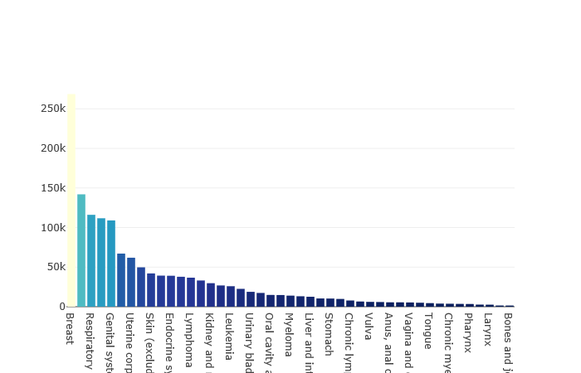
Graph to show different types of Cancer in females and their frequency

Slide 6
Clarification of X - Axis
Breast , Digestive system , Respiratory system, Lung and bronchus, Genital system, Colorectum, Uterine corpus, Colon (excluding rectum), Skin (excluding basal and squamous), Melanoma of the skin, Endocrine system, Thyroid Lymphoma, Non-Hodgkin lymphoma, Kidney and renal pelvis , Pancreas, Leukemia,Ovary ,Urinary bladder, Rectum , Oral cavity and pharynx , Other and unspecified primary sites , Myeloma , Cervix , Liver and intrahepatic bile duct , Brain and other nervous system , Stomach, Acute myeloid leukemia, Chronic lymphocytic leukemia, Gallbladder and other biliary, Vulva, Mouth, Anus, anal canal and anorectum, Soft tissue (including heart), Vagina and other female genital, Small intestine,Tongue, Esophagus, Chronic myeloid leukemia, Hodgkin lymphoma, Pharynx, Acute lymphocytic leukemia, Larynx, Eye and orbit, Bones and joints.

Slide 7
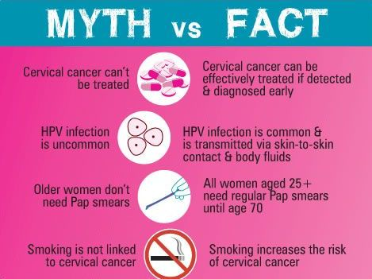
Actual facts of what we found out
Most common type of cancer found in woman's Breast Cancer
Least common type of cancer found in women is Bone Cancer in the joints
Cancer is treatable most of the time ( when caught early/ on time )
Yet cancer is one of the most popular leading causes of deaths

Slide 8

How we did it
The program used for coding was Spyder
Language used: Python
Libraries used:
Pandas: To analyze and label the data
Plotly: To graph and organize

Slide 9
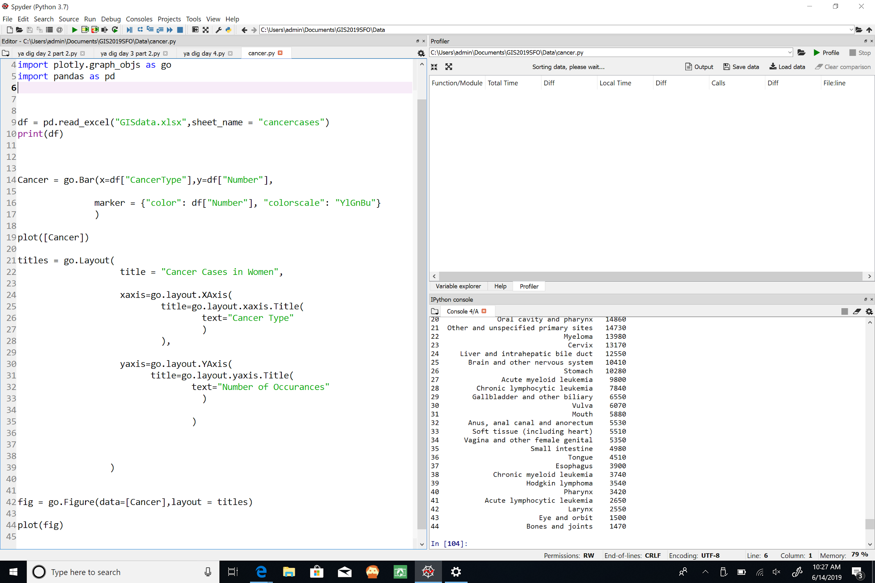
Our Code

Slide 10
inferences/conclusion
From our graph we gathered that :
We could conclude that there are roughly 1 million total cases found in women
The Cancer types with the highest amount of cases are Breast Cancer (approx. 270 thousand cases) and Respiratory Cancer (approx. 141 thousand cases)
- Cancers like Bone Cancer Joint (1470) and Eye Cancer (1500) are the least occuring forms of cancer.

Slide 11

Thanks For Listening
Any Questions?
:)

Slide 12
Sources
“Spyder.” Bing, Microsoft, www.bing.com/images/search?q=spyder%2Blogo&qs=n&form=QBILPG&sp=-1&pq=spyder%2Bl&sc=8-8&sk=&cvid=72873D84C112459E93A73DF865B562EA.
“Cancer Facts.” Word Press, 2015, farajacancersupport.files.wordpress.com/2016/01/cervical-cancer-myths-2015.jpg.
““Medical Photo.” Bing, 2014, cta.tech/CTA/media/BlogImages/2014/medical.jpg.
“Cancer Photo.” Bing, Microsoft, www.bing.com/images/search?view=detailV2&ccid=9owc15bO&id=0876DE65586FF2D85ED51737F04F28E51A48C041&thid=OIP.9owc15bO0yJq_53ISbZzigHaFj&mediaurl=https%3A%2F%2Fpublichealthwatch.files.wordpress.com%2F2014%2F04%2Fbreast-cancer-awareness-month-1.jpg&exph=546&expw=728&q=%2Bwomen%2Bcancer%2Bpictures&simid=608011151466499601&selectedIndex=21&ajaxhist=0.

